Slide 1

In the name of god
Headache
DR Rahimijaberi MD

Slide 2
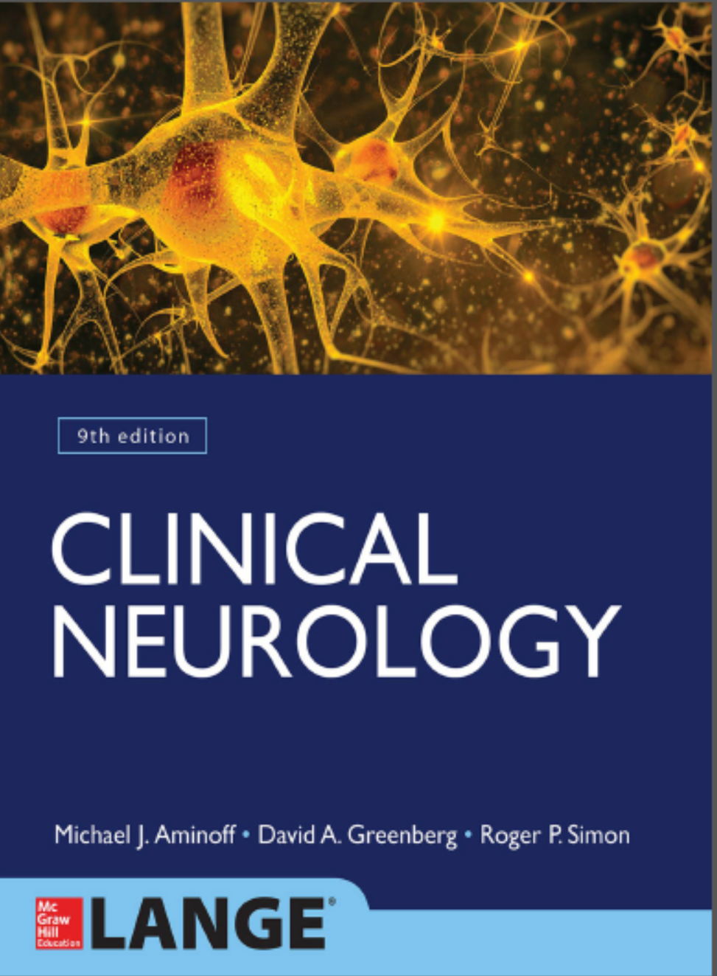

Slide 3
Headache occurs in all age groups and accounts for 1% to 2% of emergency department evaluations and up to 4% of medical office visits;
the causes are myriad .
Although most often a benign condition (especially when chronic and recurrent), headache of new onset may be the earliest or the principal manifestation of serious systemic or intracranial disease and therefore requires thorough and
systematic evaluation.

Slide 4
Headache
Headache is caused by traction, displacement, inflammation, vascular spasm, or distention of the pain-sensitive structures in the head or neck.
Isolated involvement of the bony skull, most of the dura, or most regions of brain parenchyma does not produce pain

Slide 5
Pain sensitive structures within the cranial vault
include the venous sinuses (eg, sagittal sinus); anterior
and middle meningeal arteries; dura at the base of the
skull; trigeminal (V), glossopharyngeal (IX), and vagus (X)
nerves; proximal portions of the internal carotid artery and
its branches near the circle of Willis; brainstem periaqueductal
gray matter; and sensory nuclei of the thalamus

Slide 6
Extracranial pain _sensitive structures
These include periosteum of the skull; skin; subcutaneous
tissues, muscles, and arteries; neck muscles; second (C2) and
third (C3) cervical nerves; eyes, ears, teeth, sinuses, and
oropharynx; and mucous membranes of the nasal cavity

Slide 7
Radiation or projection pain
A. The trigeminal (V) nerve
carries sensation from intracranial structures in the anterior and middle fossae of the skull (above the cerebellar tentorium).
Discrete intracranial lesions in these locations can produce pain that radiates in the trigeminal nerve distribution
B. The glossopharyngeal (IX) and vagus (X) nerves convey
sensation from part of the posterior fossa; pain originating in this area may also be referred to the ear or throat, as in glossopharyngeal neuralgia.
C. The upper cervical (C2-C3) nerves
transmit stimuli from infratentorial and cervical structures; therefore, pain from posterior fossa lesions often projects to the second and
third cervical dermatomes

Slide 8
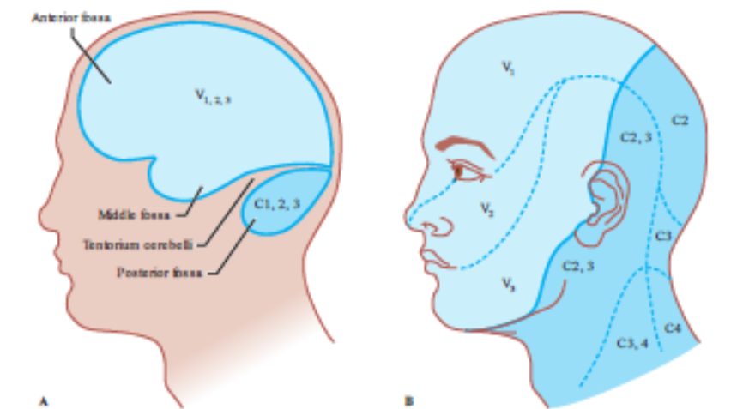

Slide 9
Headache disorders are classified as primary or secondary (International Headache Society Classification Subcommittee, 2004).
The primary headache disorders do not have an underlying structural cause, but all the primary headache disorders can be simulated by secondary conditions

Slide 10
Headache
Onset of Headaches
Temporal Profile
Time of Day and Precipitating Factors
Associated symptoms
Underlying disease
Drug history

Slide 11
Primary headaches
Tension headaches
Migraine headaches
Cluster headaches

Slide 12
Migraine headache
Migraine is common (prevalence 12%) and is manifested by recurrent headache, which is usually unilateral and frequently pulsatile in quality and often associated with
nausea, vomiting, photophobia, phonophobia, and lassitude.
Prodromal symptoms affecting mood, appetite, or cognition occur in many patients.

Slide 13
IHS criteria of migraine:
A-4-72 hrs
B - > 5 attacks of headache
C : 2 of these :
1-unilateral headache
2-pulsating
3-moderate to severe
4 –exacerbate with exercise
D: one of these :
1- nausea or vomiting
2 photophobia and phonophobia

Slide 14
Migraine headache
The migraine attack begins with visual or other neurologic (usually sensory)
symptoms in approximately 15% to 20% of patients (migraine with aura, or classic migraine), followed by the headache phase.
In most cases, however, no aura occurs (migraine without aura, or common migraine).

Slide 15
Migraine headache
Before puberty, males and females are equally affected.
After puberty, two-thirds to three-quarters of migraine cases occur in women.
Onset is early in life— approximately 25% begin during the first decade, 55% by age 20, and more than 90% before age 40.

Slide 16
Genetic
Susceptibility to migraine is strongly influenced by genetics. A family history of migraine in at least one first-degree relative is present in most cases, and twin studies demonstrate the involvement of both genetic and environmental factors.
Autosomal dominant inheritance of migraine occurs in several well-recognized syndromes, including familial hemiplegic migraine and cerebral autosomal dominant arteriopathy with subcortical infarcts (CADASIL)

Slide 17
Pathophysiology
Intracranial vasospasm (aura)
Extracranial vasodilation(pain)

Slide 18
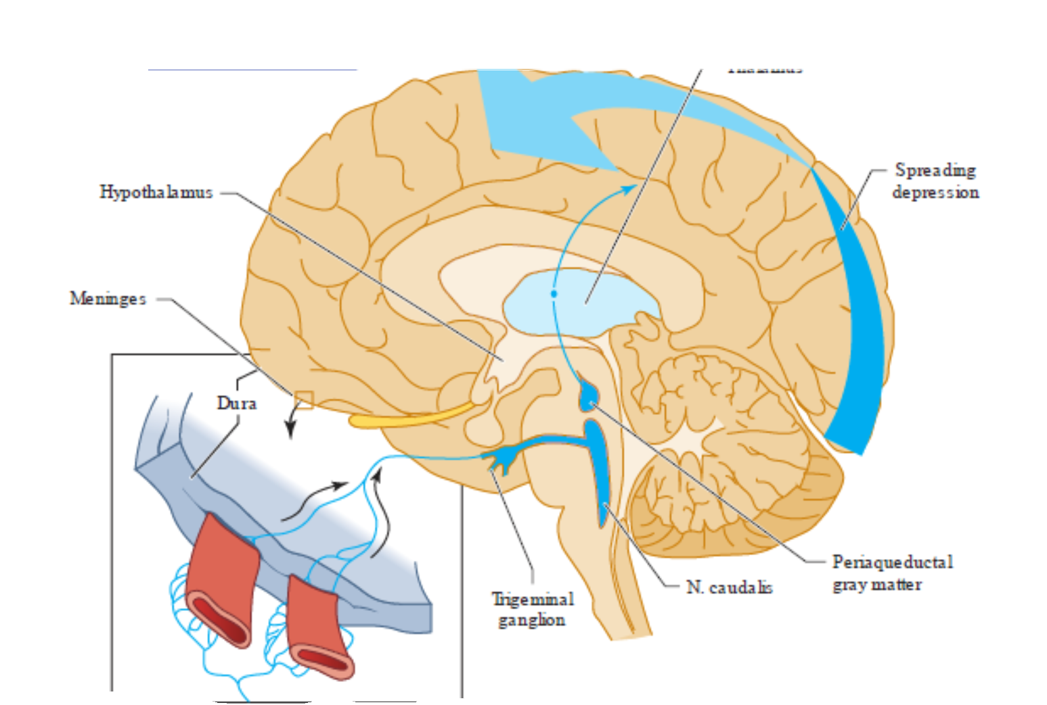

Slide 19
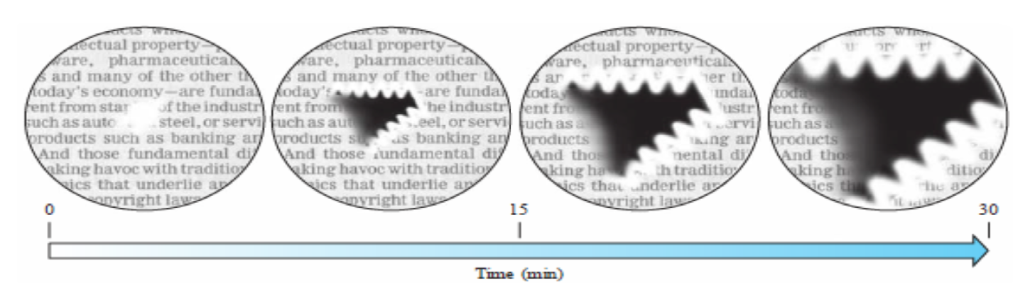
Aura

Slide 20
Cluster headache
Cluster headache presents as clusters of brief, very severe, unilateral, constant, nonthrobbing headaches that last from 15 minutes to 3 hours.
Unlike migraine headaches, cluster headaches are always unilateral and usually recur on the same side in any given patient.
They occur most often at night, awakening the patient from sleep, and recur
daily, often at nearly the same time of day (circadian periodicity), for a cluster period of weeks to a few months.

Slide 21
Cluster Headache
Patients may pace restlessly during attacks. Between clusters, the patient may be free from headaches for months or years.
The cause is unknown, but functional MRI during attacks has shown hypothalamic activation.
Cluster headache occurs much more frequently in men than in women and typically begins at a somewhat later age than migraine (mean onset at 25 years).
There is rarely a family history.
The headache may begin as a burning sensation over the lateral aspect of the nose or as pressure behind the eye .The pain is sharp, or stabbing. Ipsilateral conjunctival injection, lacrimation, nasal stuffiness, and Horner syndrome are commonly associated with the attack.
Episodes may be precipitated by the use of alcohol or vasodilating drugs, especially if used during a cluster siege.

Slide 22
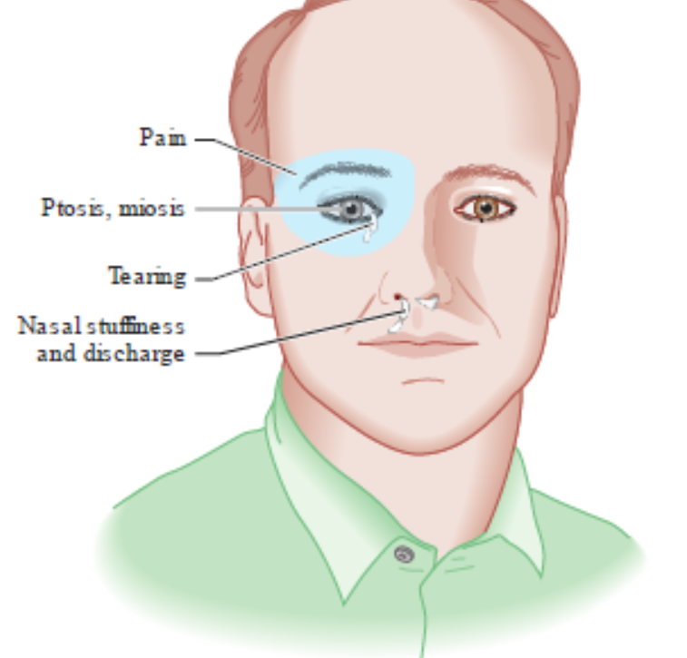

Slide 23
Tension type headache
Tension-type headache is the term used to describe chronic or recurrent headache of in apparent cause that lack features of migraine or other headache syndromes
In its classic form tension-type headache is a chronic disorder that begins after age 20 years.
It is characterized by attacks of non throbbing, bilateral occipital head pain that is not associated with nausea, vomiting, or prodromal visual disturbance.
Headache duration is from hours to days. The pain is sometimes likened to a tight band around the head
Women are more commonly affected than men.

Slide 24
